Slide 1
Phased Local Search for Optimising Minimum Vertex Covers in Dense Unweighted Graphs
Zaymon Foulds-Cook s5017391
School of Information Communication Technology
Griffith University, Gold Coast Campus
Gold Coast, QLD, Australia

Slide 2
Abstract
—This paper defines a real coded approach to searching for minimal vertex covers in dense graphs. The proposed search approach failed to perform to expectations, however, still yielded results within close margins of the minima.

Slide 3
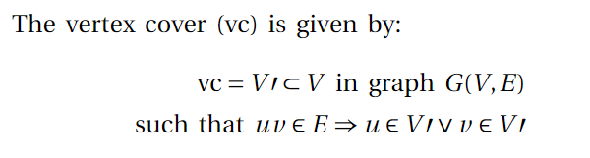
Problem Statement
A minimal vertex cover is the smallest possible vertex cover for a graph G.
That is to say the minimal set of vertices where every edge in graph G(V,E) has at least one endpoint to a vertex in the vertex cover.

Slide 4
Applications
Developing efficient algorithms for the mvc problem has applications in various fields:
The SNP assembly problem in computation biochemistry can be resolved by finding the minimum vertex cover in order to resolve conflicts between sequences in a sample (Pirzada, 2007).
Another use for finding the mvc is in computer net-working security as a team of computer scientists affiliated with the ‘Virology and Cryptology Lab’ and the French Navy, ‘ESCANSIC’ “... have recently used the vertex cover algorithm [6] to simulate the propagation of stealth worms on large computer networks and design optimal strategies for protecting the network against such virus attacks in real-time." (Pirzada, 2007)

Slide 5
Algorithm Description
The algorithm used in this experiment attempts to use phased local search.
The search algorithm uses iterative phases of set building, plateau search and set reduction in an attempt to improve a solution.
The algorithm initially utilizes a greedy search to build the initial set where the heuristic is the number of nodes adjacent to a prospective node subtracted by the number of adjacent nodes which are already contained within the cover set.

Slide 6
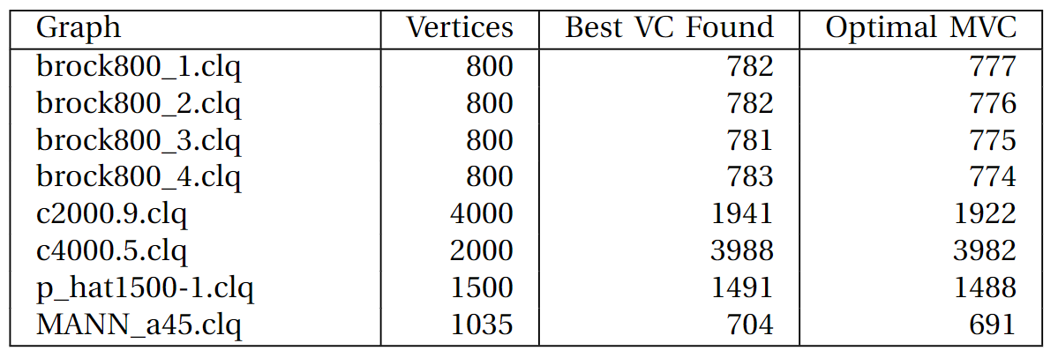
Results

Slide 7
Conclusions
This study has shown that by applying elements of phased local search to the minimal vertex cover problem, solutions can be found within a small margin of the minima in most cases. To improve the efficiency and effectiveness of the algorithm further research and experimentation is needed.
By experimenting with node selection approaches and developing different methods for plateau search future studies are likely to produce results which will rival or surpass the approach taken.

